Slide 1
NAFLDdb

Slide 2




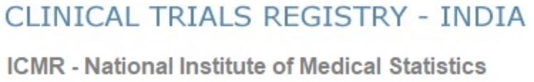













Data Integration
E-utilities API
Source Data Collection
Curating and Annotation
Association and Integration
Analysis and Calculation
Research Articles
Clinical Trials
Manual Curation
Associated Diseases
Therapy Strategies
Therapy Targets
Annotation
Therapy Agents
Data Association
Drug Candidates
Bioactive Compounds
Natural Products
Drug-like Properties Calculation
CMap Candidates
GSE126848
GSE135251
Connectivity Scores
Connectivity Scores Calculation

Slide 3

Full-Text Search
Search Results
Data Browse
KnowledgeBase Curation
Overview
Recent Results and Discoveries
Update News
Therapy Strategies
Dataset View
Details / Knowledge Graph / Associated Data
Therapy Targets
Dataset View
Details / Knowledge Graph / Associated Data
Associated Diseases
Dataset View
Details / Knowledge Graph / Associated Data
Clinical Trials
Dataset View / Filter
Details / Knowledge Graph / Associated Data
Therapy Agents
Dataset View / Filter
Details / Knowledge Graph / Associated Data
Browse
Drug Candidates
Dataset View / Filter
Details / Knowledge Graph / Associated Data
Bioactive Compounds
Dataset View / Filter
Details / Knowledge Graph / Associated Data
CMap Candidates
Dataset View / Filter
Details / Knowledge Graph / Associated Data
Natural Products
Dataset View / Filter
Details / Knowledge Graph / Associated Data
Research Articles
Dataset View
Details / Knowledge Graph / Associated Data
Structure Search
Structure Input / Preferences
Search Results
Drug-like Screening
Screen Conditions Seting
Screen Results
Tools
Repositioning Tool
Reposition Mode Seting
Reposition Results
Case Study
Case Study Visualization
Downloads
Datasets Downloads
About
Introduction and Tutorials

Slide 4
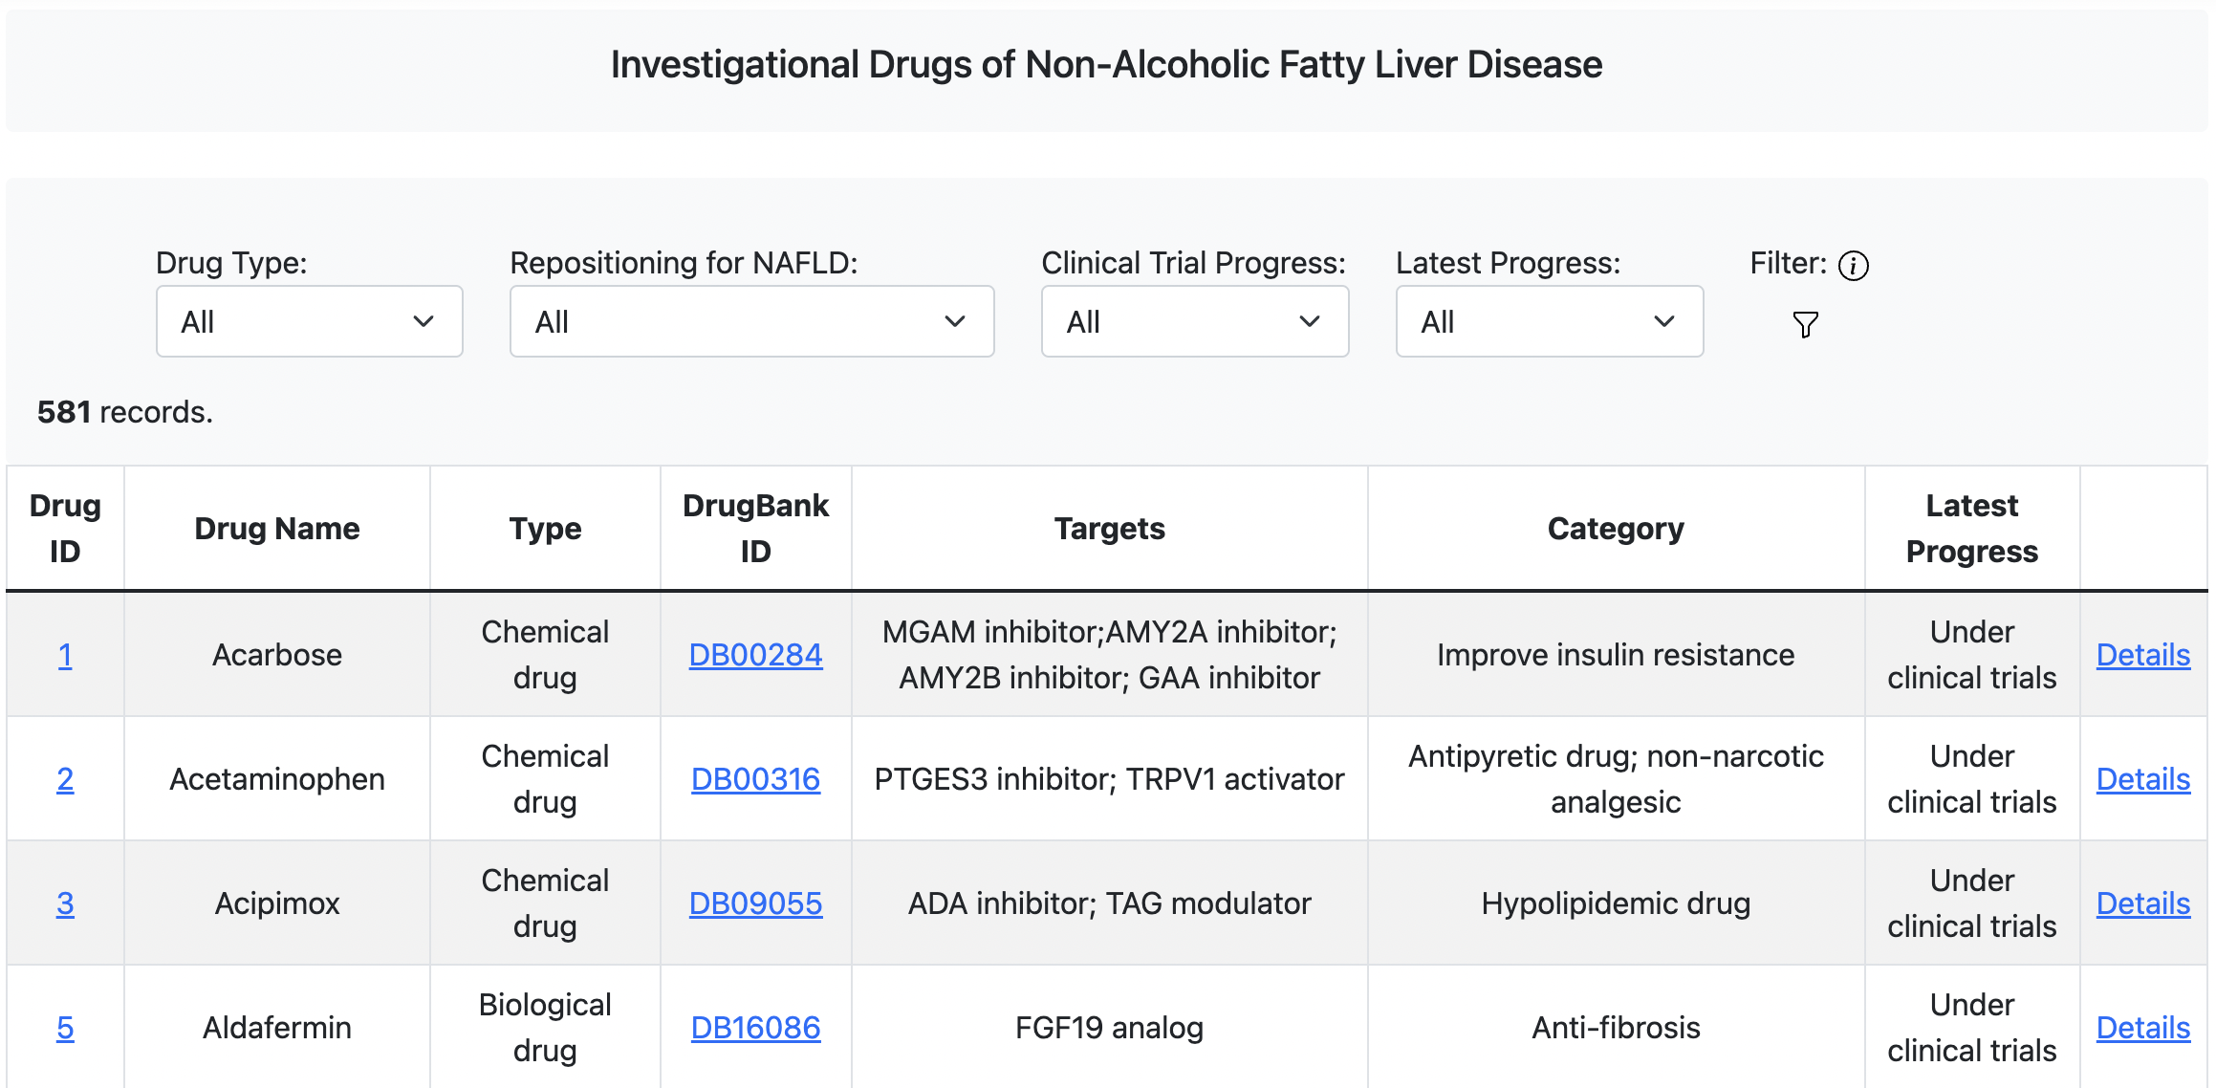

Slide 5
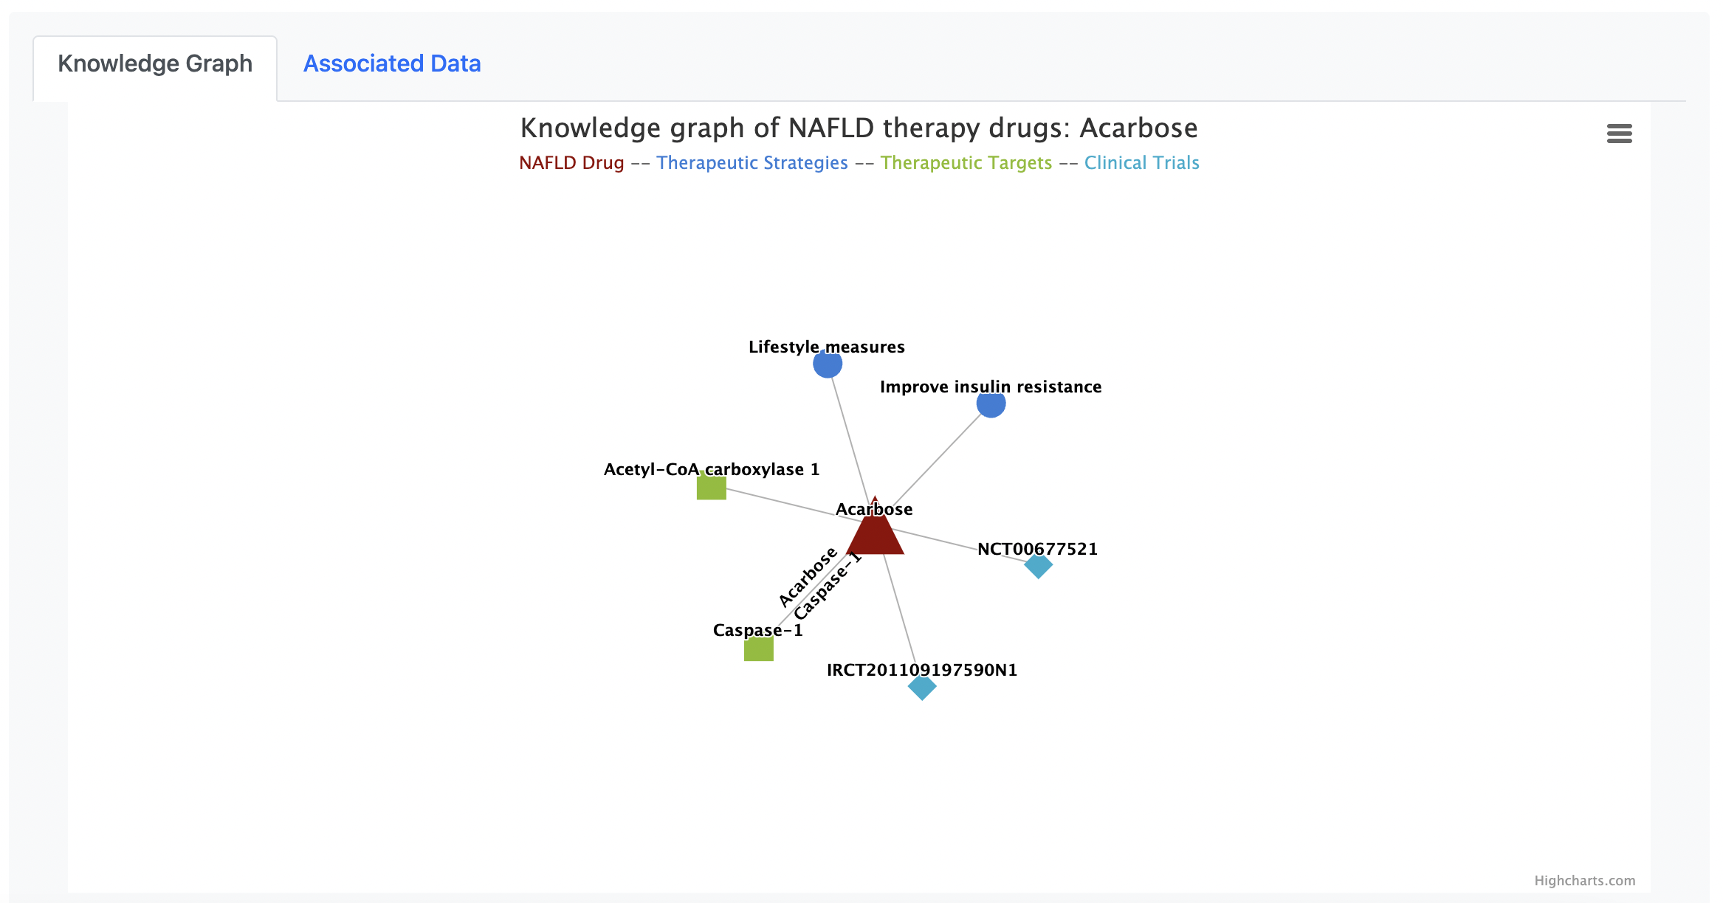

Slide 6
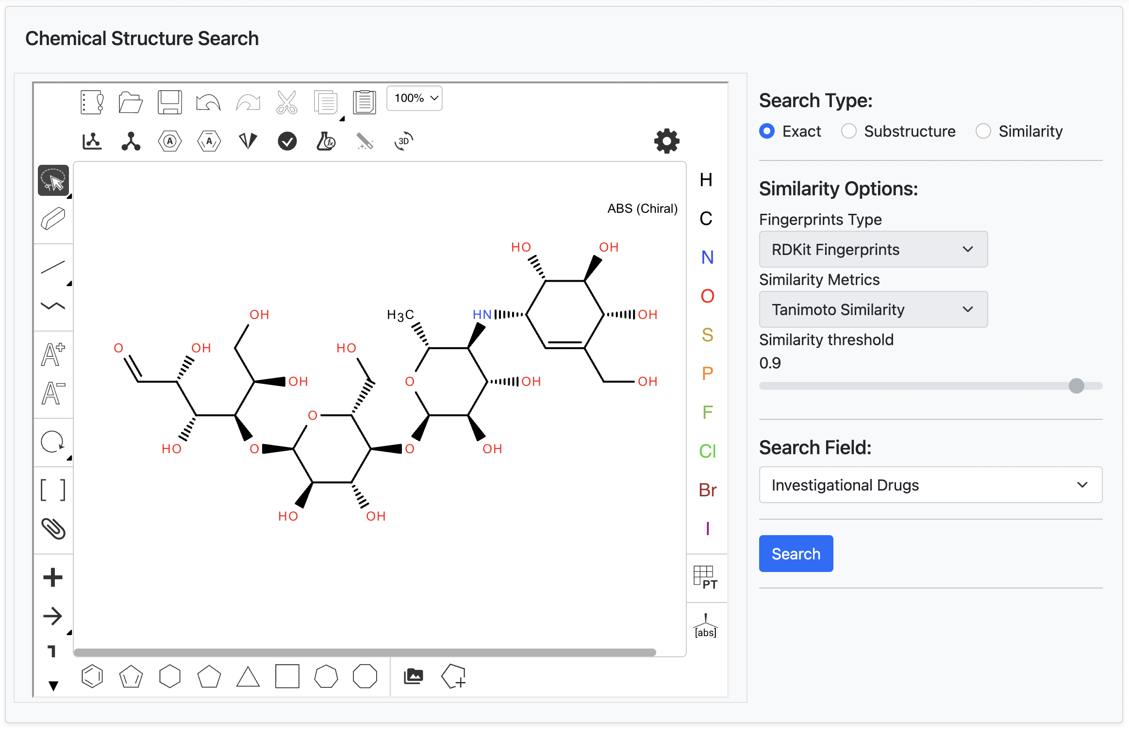

Slide 7
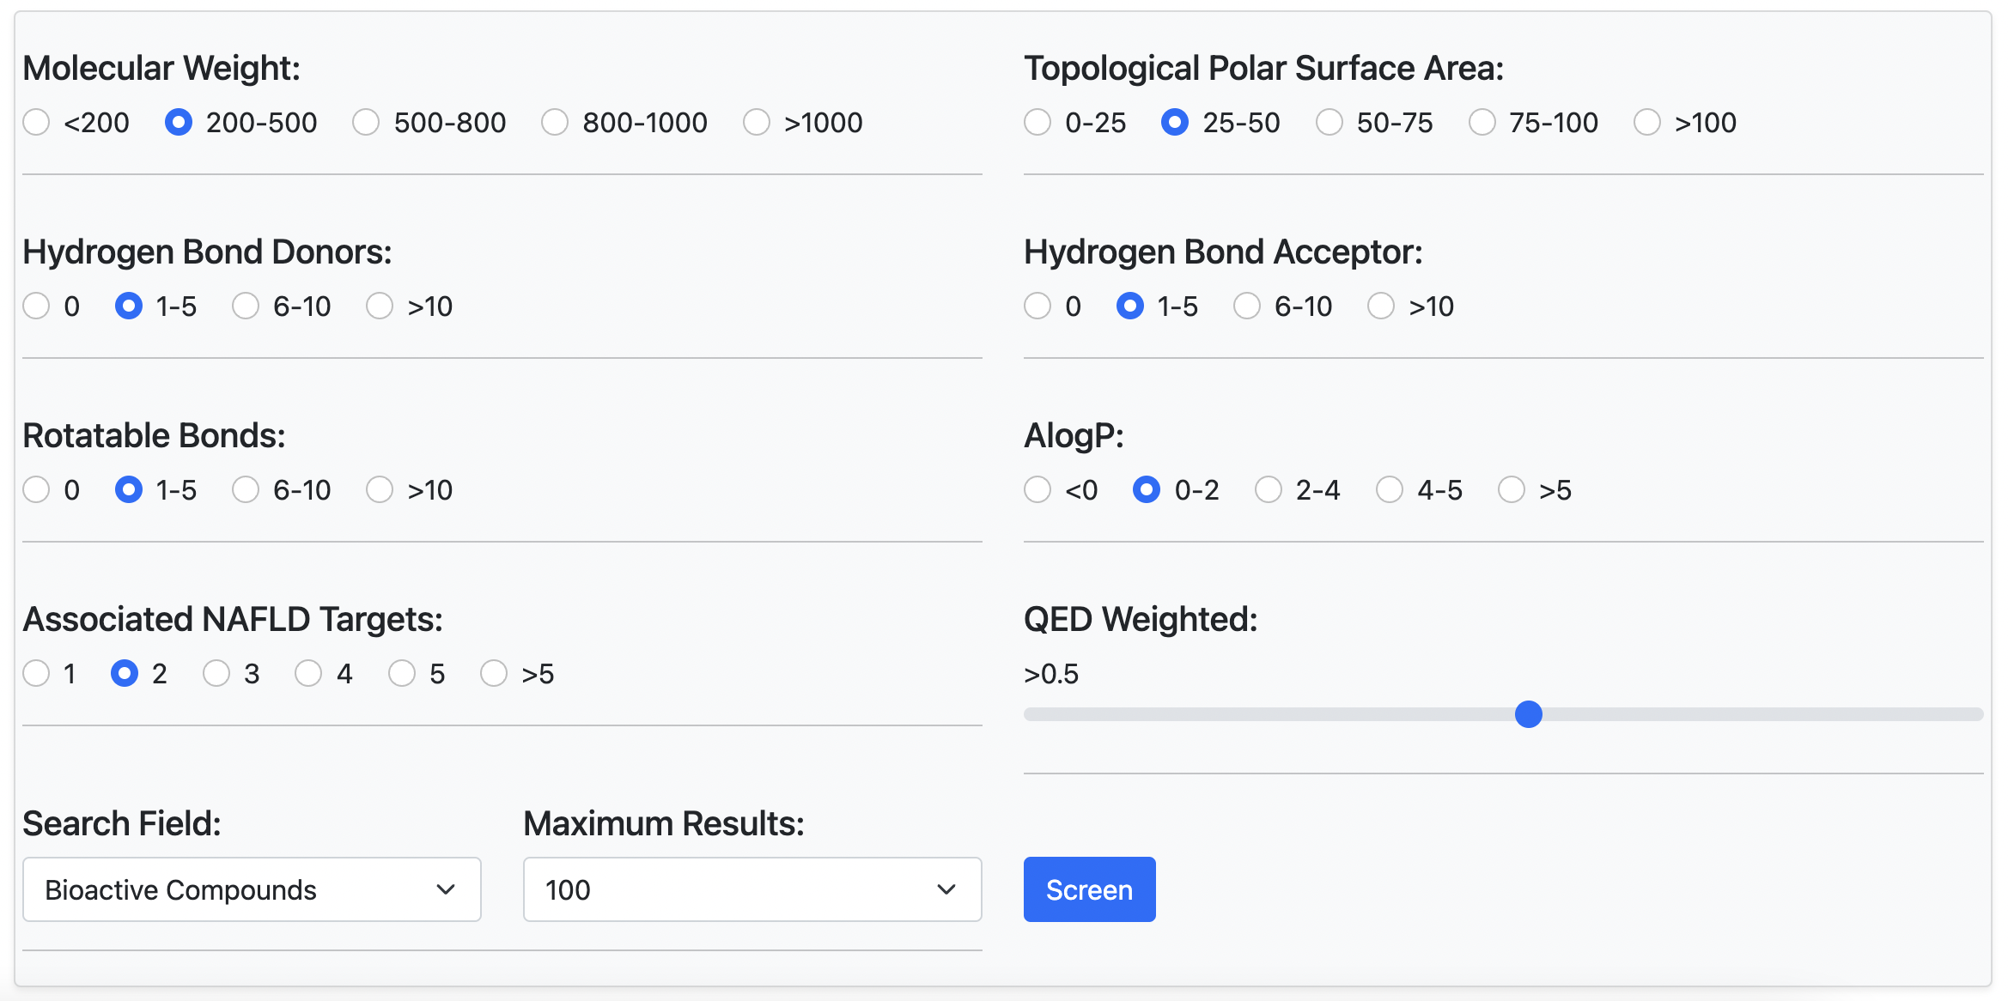

Slide 8
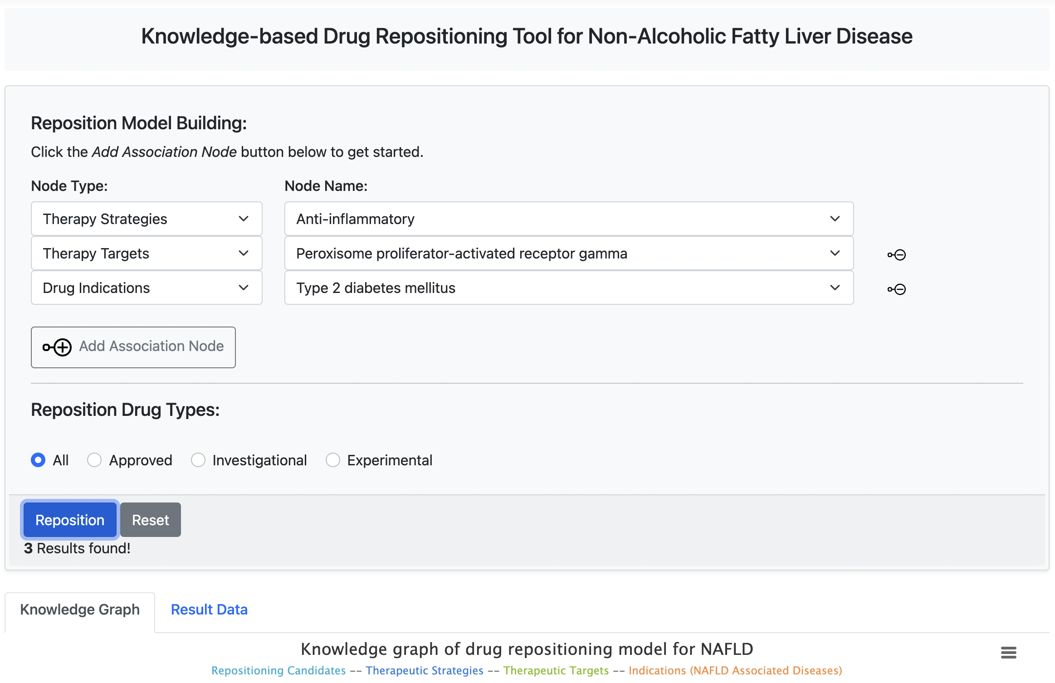

Slide 9
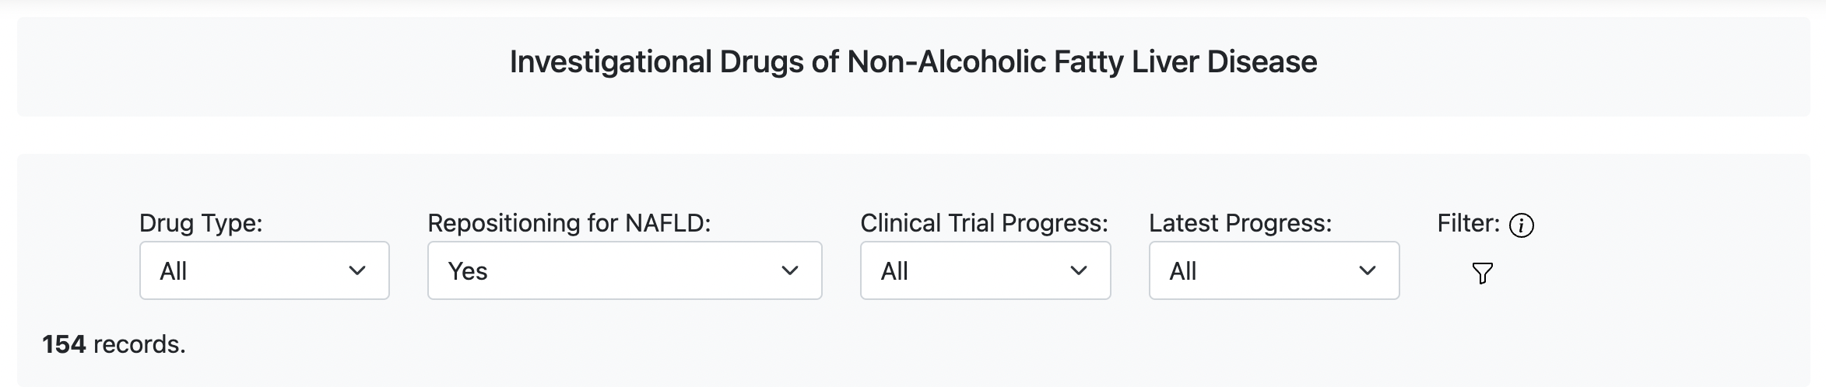

Slide 10
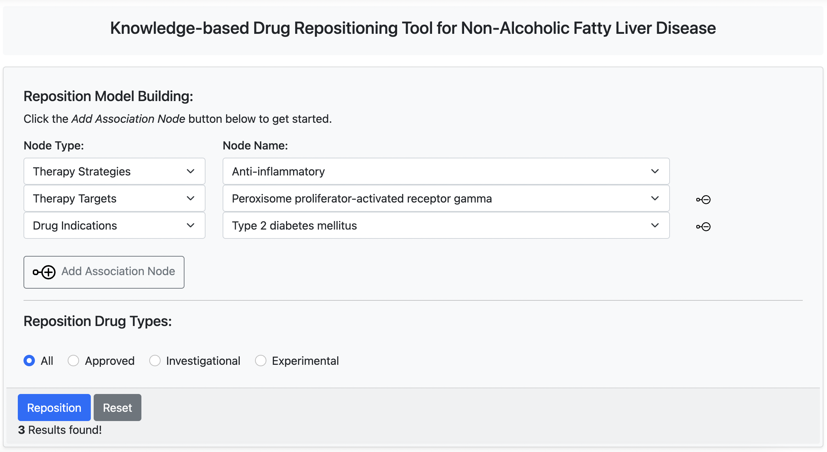

Slide 11
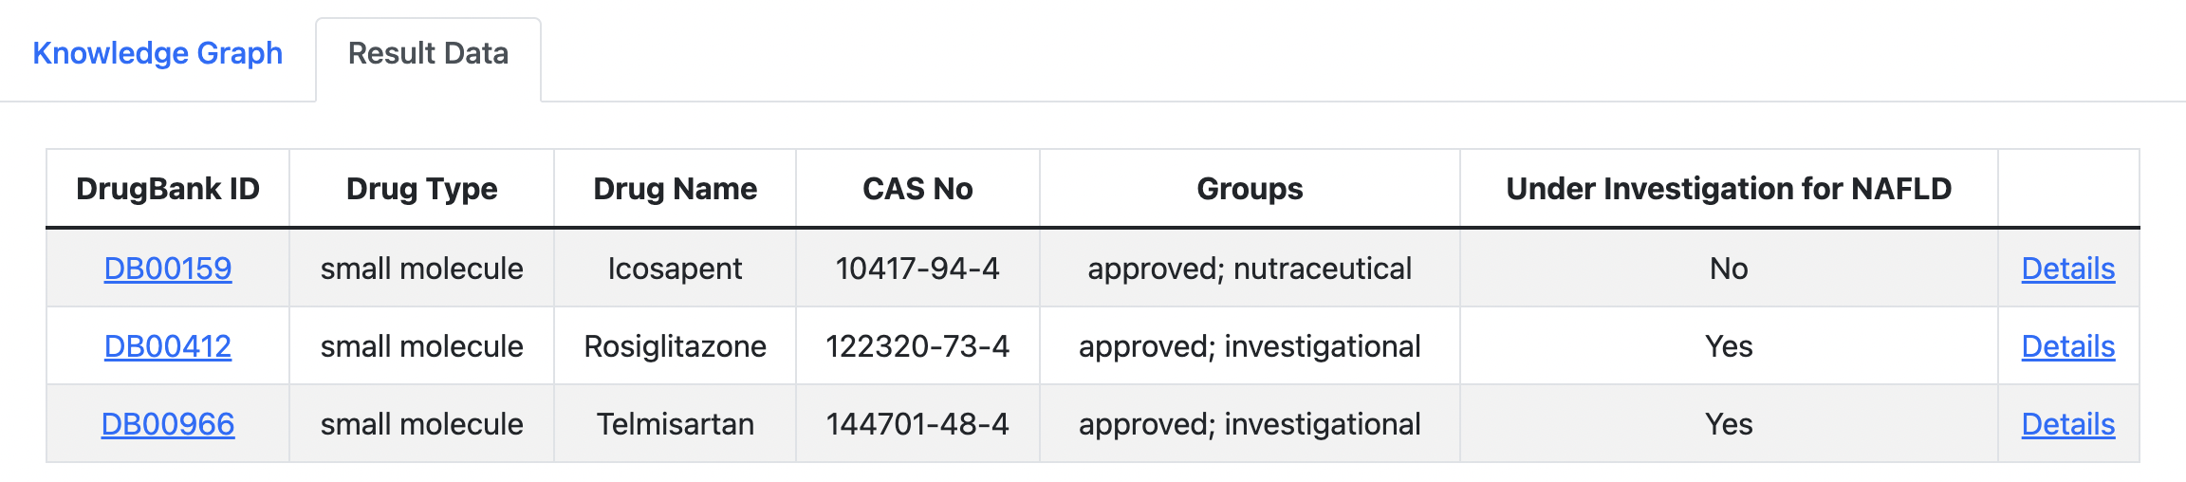

Slide 12
